Slide 1
The 2015 Croatian renewable law: one step forward (and now back?)
Ana-Maria Boromisa
II Ener-Mar-Corp-Comm
Zagreb, 31st March 2017
Acknowledgement: This work has been supported by the Croatian Science Foundation under the project number IP- 2013-11-2203

Slide 2
Development of renewable policy in Croatia
2001: the first package of energy law Use of renewable energy – interest of Republic of Croatia
2002 the Energy Strategy
2003: Establishment of the Environmental Protection and Energy Efficiency Fund
2004: the new set of energy laws
2005: establishment of market operator HROTE
2006: Croatia joined the Energy Community; EU accession negotiations started

Slide 3
Development cont’d
2007: Financial incentives: feed in-tariff; 14 years : depending on technology and size of power plant
2007-2016: 3 tariff systems (OG 33/07, 63/12 i 133/13 )
2009: new Energy Strategy
2020 goals: 20% of renewable in final consumption 2020
35% in production of electricity, 10% in transport, 20% in heating and cooling

Slide 4
Within the EU
2012-2013: new round of alignment with EU
Introduced the certificates – Guarantee of Origin
Center for monitoring business activities and investment in energy sector established
Renewable energy action plan until 2020 (not published in the Official Gazette); differnt projections than in Energy Strategy
2014: new tariff system
reduced support for solar and wind
biogas, biomass and small hydro – almost the same

Slide 5
2015
Revoked regulation:minimum share of RES by 2020 (18% in 2013) signal to investors: no new support
The Renewable Energy and High Efficiency Cogeneration Act (Sept. 2015)
Finalise transposition of the EU acquis (renewable energy - Directive 2009/28/EC and the energy efficiency directive -Directive 2012/27/EC)
State aid?
Gradual introduction market-based instruments
Replacement feed in with market premium model

Slide 6
Timing and preparation
pushed through Parliament at its last session before the elections – an expedited procedure:
the government initiated the legislative procedure on September 1, and the law was adopted on September 10
Government’s amendments (on September 9), including a 20% reduction of the regulated price suppliers have to pay for renewable energy in 2016.
Explanation: the need to (finally) comply with EU legislation, Entry into force: January 1, 2016, with some provisions only entering into force on January 1, 2017.
Elections November 8th
The bidding process and ceilings: implementing regulation (end January 2016).

Slide 7
2016
1st January: entry into force of new law
Existing contracts in force, procedures started in 2015 under the „old” rules concluded in 2016: 109,411 kW
1 Hydro power plant 130 kW, 3 biomass 1584 kW, 8 Biogas:7700 kW, Cogeneration 100.000 kW
Procedures missing:
Regulation on quotas incentivising generation of electricity from renewables;
Rulebook on renewbales and high efficient congeneration,
State aid programme

Slide 8
Quota until 2020 (TS 2015, OG 100/2015)
TYPE OF RES TECHNOLOGY |  | QUOTA (MW)
Hydro ≤ 10 MW |  | 35
Geothermal |  | 30
Wind |  | 744
Biofuels | Biomass from forestry, agriculture and waste | 120
Biogas | including waste gas and gas from water treatment plants | 70

Slide 9
TECHNOLOGY. | Number o | Installed capacity (kW) | Contracts activated 2016 (kW) | Pending contract (kW)
Wind | 18 | 412.000 | 34200 | 326000
Solar | 1219 | 49.479 | 5496 | 3892
Hydro | 11 | 3.885 | 898 | 4164
Biomass | 12 | 25.955 | 1370 | 93972
Biogas | 26 | 30.435 | 8502 | 25785
Cogeneration | 6 | 113.293 | 100000 | 0
Geothermal | 0 | 0 |  | 10000
Waste gas PP | 1 | 3.000 |  | 0
E. Gas Waste water | 1 | 2.500 |  | 0
Total | 1294 | 640.547 | 150.464 | 463.813

Slide 10
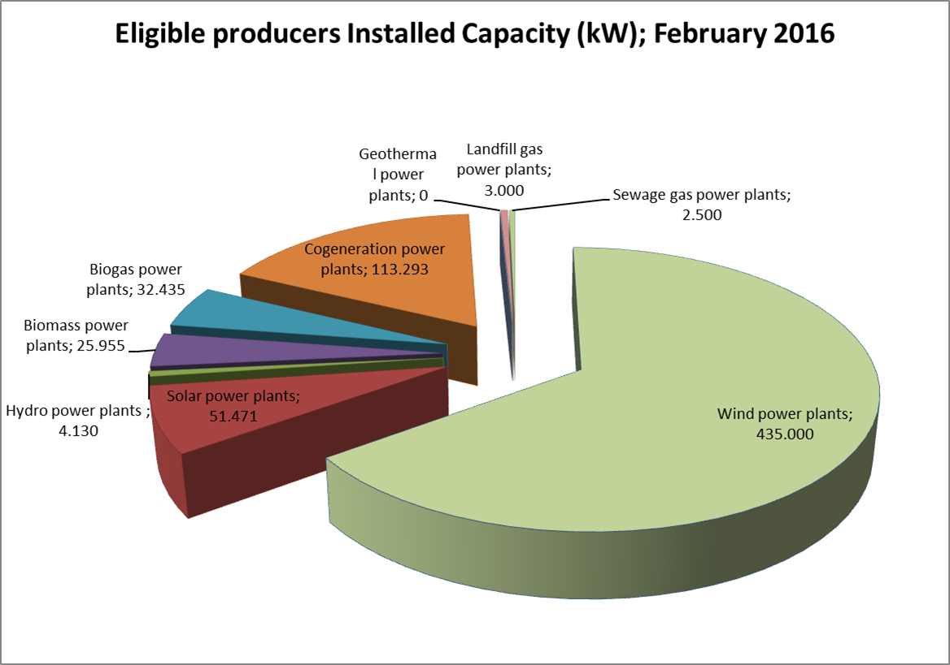
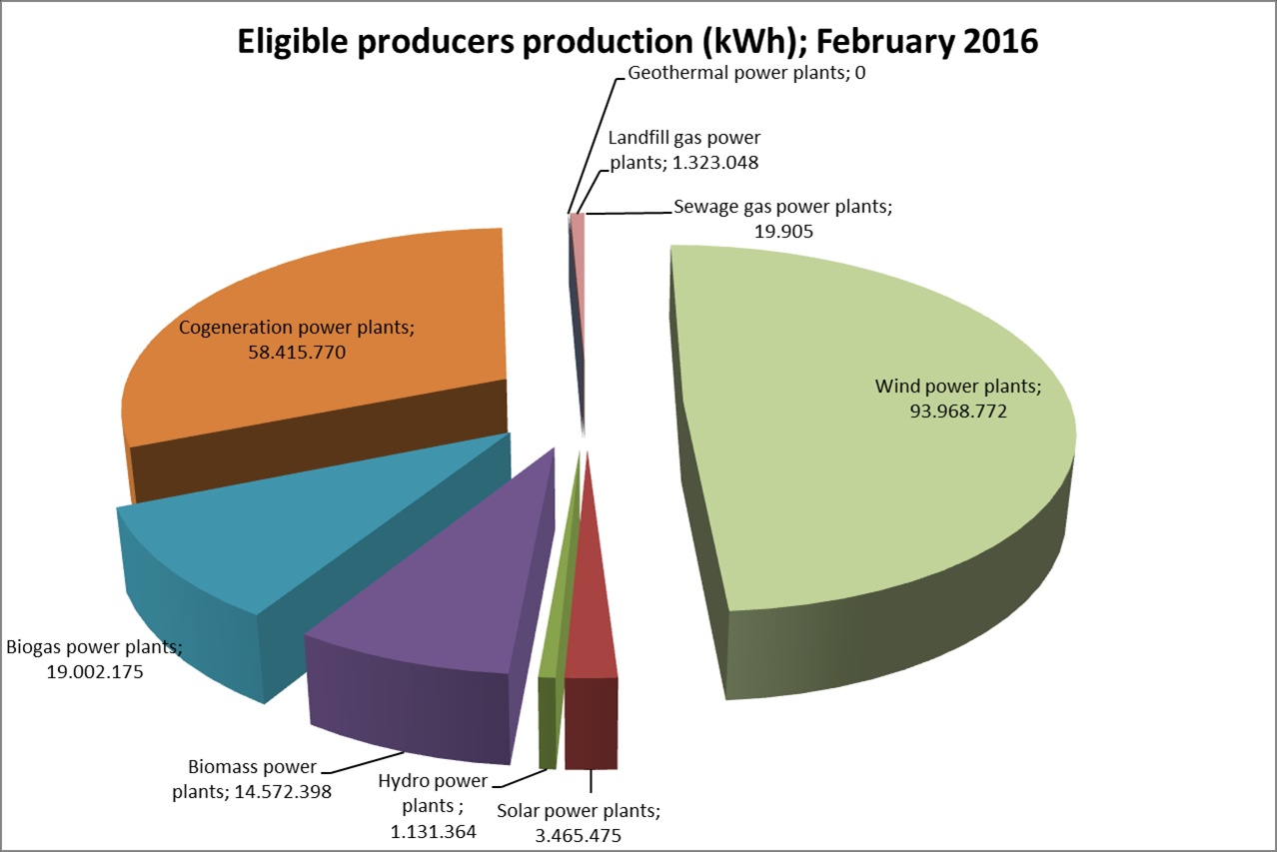
Installed capacity (640 MW)

Slide 11
Incentives in 2016
No of contracts | 1399 (1294 active) 1 expired (Ravne Wind Power Plant)
Installed capacity | 640.547 MW
Production | 1,725,935 MWh |  | 11 % | 15,551,386 MWh
Collected fee/surcharge on bill | 514,699,654.95 kn
Sale | 724,893,107.82 kn
Total collected | 1,239,592,762.77 kn
Paid | 1,546,551,464.76 kn
Difference | -306.958.701,99 kn

Slide 12
Financial results 2007-2016
 | kn | Eur, million
Collected fee (surcharge, currently 0,035 kn/kWH) | 2,243,813,985 | 299
Collected (suppliers obligation) | 2,474,050,484 | 330
Total collected | 4,717,864,470 | 629
Paid: feed in tariff | 4,625,133,309 | 617
Balancing costs | 60,275,520 | 8
Service (suppliers), 1.5% PPC | 3,262,279 | 0.4
Total cost | 4,688,671,110 | 625
 | 29,193,359 | 3.9

Slide 13
Planned (law)/implementing regulations
Quotas and bidding procedrue: by the end January 2016
starting in 2017, producers of renewable energy will be subject to balancing responsibilities
A special (simplified) regime will be provided for small installations (up to 500kW), and their suppliers will have to take on the electricity-surplus they produce.
competitive procedures for the use of state property for renewable energy installations. All the potential investors will have to go through a tender procedure to obtain a right to build or land a lease agreement.
the implementation of the new act will create new jobs and require additional funds in the state budget.

Slide 14
New projects 2016
DENIED
Type of technology | Number of projects | Planned capacity, kW
Biomass | 4 | 1,374
Solar | 1 | 27.3
Total | 5 | 1,401

Slide 15
2016
National Reform Plan 2016
Adoption of new energy strategy
Adoption of new Renewable Energy Action Plan
Adaption of implementing regulations for Renewable Energy Sources and Highly Efficient Cogeneration Law
Merger HERA and HROTE
The Low Carbon Development Strategy until 2030 with view until 2050 (planned 2015, postponed 2016...)
Government adopted Regulation changing The Renewable Energy and High Efficiency Cogeneration (29 December 2016, entry into force 31 December 2016, OG 123/2016)
extension of obligation to buy electricity from eligible producers until 31 December 2017, 0,42 kn/kWh
Postponed EKO balancing group – operational by 1st January 2018
Derogation of Article 40 (defining sale of electricity from eligible producers)

Slide 16
Current information
Programme of the government 2016-2020
2050 Energy strategy: security of supply, competitive prices, including renewables, coherent with Low carbon development strategy 2030
Specific goals: Improved security of oil suply
Improved security of gas supply
RES employment: 1759 jobs
Decreased VAT (25-13%); proposal to introduce excises 10-15% (mid-February 2017)
Increasing fee from 0.035 kn/kWh to 0.075kn/kWh?
Proposal in pubic consultation
Considers EU guidelines on state aid
Considers Renewable energy action plan until 2020
Some questions: discrimination ? Is it genuine market? Is it actually possible for new entrants to gain contracts under fair terms?
.

Slide 17
Challenges
Problems: feed in tariff, supportive policies
State aid rules? Commission's Guidelines on state aid for environmental protection and energy 2014-2020 from January 2017 aid is granted on the basis of a clear, transparent, non-discriminatory competitive bidding process open to all producers of renewable electricity
Excise duties on existing projects?
Financing? Banks including HBOR?
Enhanced bankability- reduced cost of capital// reversing trend
Transposition of EU acquis: 2016 plan, 2017 plan?
Law: Zakon o postupcima za naknadu štete zbog povreda prava tržišnog natjecanja (Adopted by the Government 27.02.2017; on in the 1st reading in the parliament 17.03.2017 )
By-laws : RES implementation not listed (as of 21 March 2017)

