Slide 1
‘Rules are Rules’
Towards an Enforcement Template
‘of the Rack’
The mental map of policy makers
Notes:
Essence: Present the instruments the Commission has – but which instruments? How do they work? What roles and admin capacities does this require from Cie and MS?
Part of a wider research project: borders, asylum/migration, euro. I will present the general idea.
About enforcement: A major challenge – an enforcement challenge – Rutte: rules are rules. But: implementation problems for different reasons (nog the capacities, not the will, but also: how about the Commission and its roles?
Rules are rules – rules only work when they are not needed. -> underlines the need that when rules are not universally agreed and 100% supported, we need to think about enforcement.
‘mental map’_ what do officials know? They are laywers or economists – but what do they know about systems & management & structures?
Is it politics or design? Both: yes sensitive, but that is why we need structures & management roles – but which & from who?

Slide 2
Outline
What are the EU Enforcement models?
A suggestion for a subsidiarity based model
Notes:
Start: Mira -> Reasons for non-compliance

Slide 3
Is there an EU model of Enforcement?

Slide 4
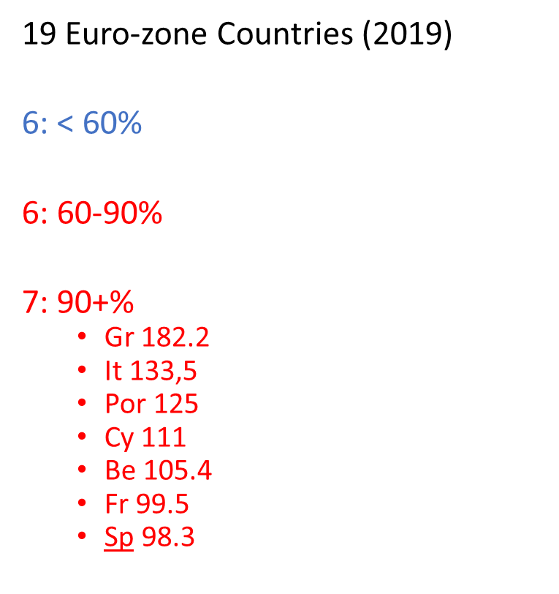
‘Enforcement crisis?’
Common EU Asylum System (CEAS)
Asylum Procedures
Reception Conditions
Qualifications Directive
(Revised) Dublin Regulation
Eurodac
Due to salience, compliance does not occur & Commission offers weak enforcement (Schmälter)
Notes:
This session is about borders and migration – but it is important for us also to think about the generalization. We should not try to reinvent the wheel in all areas – it will take too long. Moreover, we need to have a positive (effectiveness) and a normative (what kind model will work in the specific context of public expectations in mind) model
Worse off than in 2007. And that after these good years

Slide 5
Enforcement
Enforcement
Monitoring (implementation & effects), Investigating and Sanctioning
Starting point
Direct Enforcement / 1ste line : National Authorities / Agencies / Private actors / EU Agencies
Indirect Enforcement / 2ste line : Commission
Challenges
Unclear legislation, Lacking political will/Salience + Lacking capacities (EU+MS)
Notes:
Hier meteen beginnen: veel zaken zie je dat Cie de eerste lijn nr zichzelf toetrekt.

Slide 6
Approaches
Legal approach -Notifications -Reasoned Opinions -ECJ | ‘Punishment’ Cumbersome Crude in relation to causes/challenges (external shocks, season): ‘Stupid’ (Prodi) ‘We must from Brussels’, National salience Big countries? (Parce-que c’est la France) Countries are like wild horses, punishing them is not the way to tame them
Political / Persuasion | My motto is: dialogue, dialogue, dialogue (Moscovici) ‘Intelligent’ application of the SGP (Commission) Persuasion: avoided Naming & Shaming: avoided Time consuming to change behaviour
Managerial | ‘Carrots’ Financial assistance to border control, BICC, network building, EEAs, etc. Capacity building & knowledge transfer Capacity to comply ≠ Willingness to comply. Why support for (some) cap building?
Market | Raise economic costs (Euro)
Notes:
Conbination of three: sticks, negotiations & carrots / ‘market networks hierarchies’
Legal: to punish. Takes long, hard to establish (non-implementation is easy; but non-compliance is much harder- eg border control: depends on season, amount of refugees establishing reasons, etc.). Com doubts its willingness + ‘We must do it from Brussels / Scapegoating
Interesting: EU is a legal system, but apparently it does not work like that. Yes, 1 component, but not in isolation.
-> all three models failed in the SGP!?!?
-> can the Commission manage EU? Weaknesses remain – but more importantly, the Commision does not want to be a manager – a laywer, and economist. Not a manager
Ecclectic: but given 1) overload of the centre, 2) importance of the subsidiarity based model: Managerial is most important

Slide 7
Approaches
Legal approach -Notifications -Reasoned Opions -ECJ | Countries are like wild horses, punishing them is not the way to tame them
Political / Persuasion | Time consuming: years to change behaviour
Managerial | Capacity to comply ≠ Willingness to comply
To what extent have these approaches worked?
Border control, Asylum, SGP?
Centralisation?
EU Coast Guard; Weak agencies; Audit Office; Rotten Apples; Regulations
Capacity building: Willingness / awareness / what systems?
Can the Commission manage the EU – does it want to?
Notes:
Conbination of three: sticks, negotiations & carrots
Legal: to punish. Takes long, hard to establish (non-implementation is easy; but non-compliance is much harder- eg border control: depends on season, amount of refugees establishing reasons, etc.). Com doubts its willingness + ‘We must do it from Brussels / Scapegoating
Interesting: EU is a legal system, but apparently it does not work like that. Yes, 1 component, but not in isolation.
-> all three models failed in the SGP!?!?
-> can the Commission manage EU? Weaknesses remain – but more importantly, the Commision does not want to be a manager – a laywer, and economist. Not a manager
Ecclectic: but given 1) overload of the centre, 2) importance of the subsidiarity based model: Managerial is most important

Slide 8
Legal approach
Letters of Formal Notice 1492 (2005) → 727 (2017)
Infringement procedures conferred to the ECJ 254 → 41
 | 2002 | 2018
Directives | 1497 | 1014
Regulations | 299 | 4527
Notes:
- Lower interest from the Commission to pursue MS + to follow it through

Slide 9
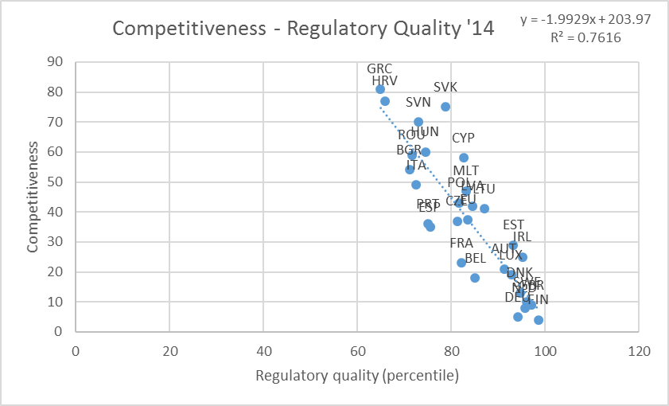
Notes:
Importance of Institutions
Yes, I understand the frustration regarding Member States as rotten apples

Slide 10
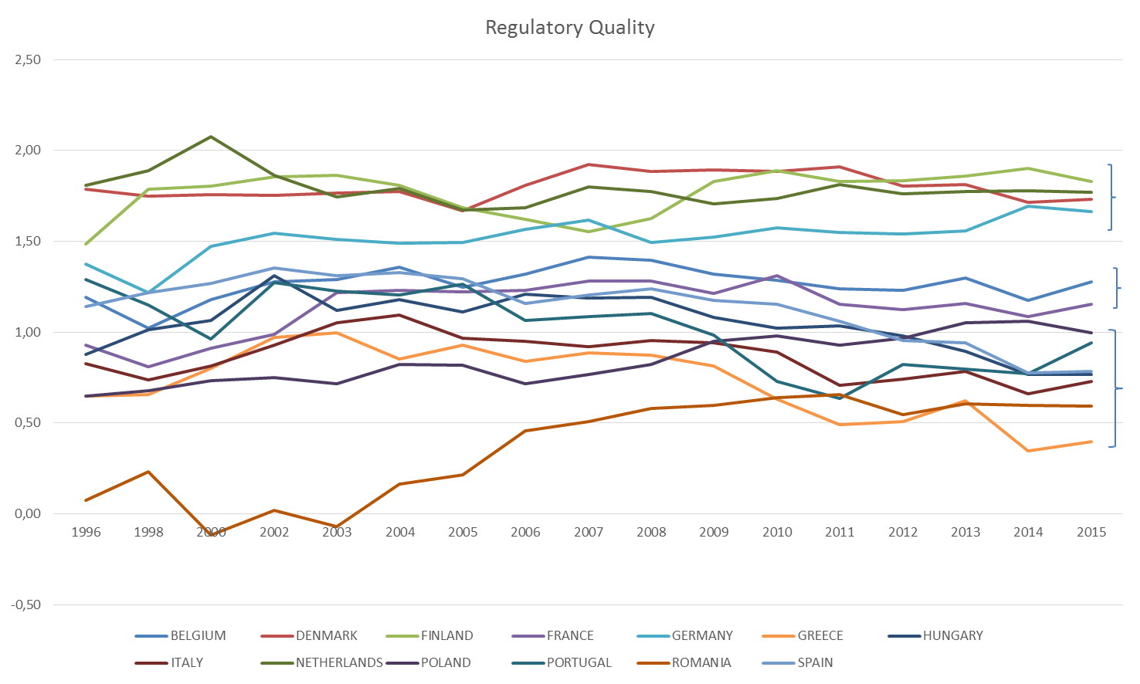

Slide 11
A Template?
‘It does not have to be this way’
Notes:
It does not have to be this way: werd in een interview gezegd: we can do it better.

Slide 12
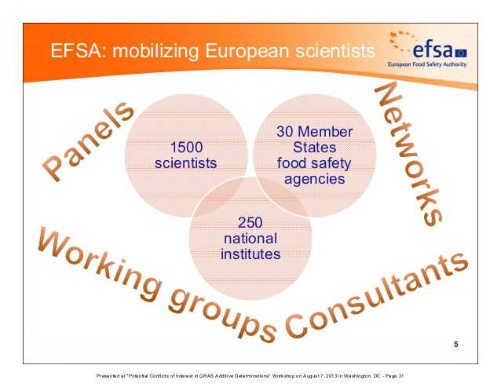
The Miracle of EFSA
Legal environment
Legal environment
Decentralised + Centralised system + Network
Team inspections + Transparency
At a distance from Commission
=>Common Culture
Aviation Safety, Medicines, Competition (?)
Notes:
benadrukL 30, 250, 1500 – en kranten-artikelen

Slide 13
‘Light approach’
National Productivity Boards,
Independent Fiscal Authorities
Regulatory authorities (‘ATR’)
7 MS, different, under-resourced, weak network, national focus (not a role in EU policy)
Commission: Checks ‘implementation’, not application/effectiveness
Few countries, the same countries (+/- 25%)
Weak networks, no shared EU-culture emerging
Who is in charge?
National sovereignty & sensitivities
‘Light’ approach
Commission in a difficult position, but also short of ideas & not keen on involving national authorities
Centralisation by default (but will not work, and certainly not with ‘borders’)
A model: practically irrelevant of matter of education?
Notes:
We may have a model, but we need to educate policy makers: to specify in the legislation, to train Com / ECA etc that they have 2nd order control

Slide 14
Commission as manager?
A multilevel management deficit?
Too much Law & Politics?
How to build strong national institutions & networks?
An Enforcement Template?
Strong national institutions + Network Agency outside the Commission + Commission as manager/initiator
Or reinvent the wheel in all areas?
How to overcome resistance in Com, MS, and Parliaments?
What role for the Commission?
Does not like agencies, separation of tasks, nor management role
Notes:
Essence: Too much of the legal and soft; too little management – but can it work??
Laatste opmerking: Enforcement is essential to solve: for trust, for public support. Hence, the question is this a model?? If so, it also means that the EU has the wrong model (political)

